Slide 1
Chapter 3 : image and graphics
Multimedia Systems

Slide 2
introduction
An image is a spatial representation of an object in 2D or 3D
In Computer Vision, an image is a digital form of the actual image or picture.
This is because they are represented by a matrix of numeric digits each represented by a quantized values.
Digital imaging is the process of creating a digital image, with digital photographs being the most familiar example.
Digital cameras use a sensor that absorbs light, turns it into digital information, and then allows a computer to recreate that information into an image
The smallest element in a digital image is known as pixel- Picture Element.

Slide 3
Basic Concepts (1.Depth)
The depth of an image is the number of bits used to represent each pixel
If N=1 bit – then 2^{N} = 2 values : Black and White (Binary Image/ Bitmap Image
4 bit – can represent 16 colors, used in low resolution screens .e.g. VGA
8-bit grey– can represent 256 shades of grey color.
0(Pure black), 255(Pure white)
8-bit color (RGB) 256*256*256 = 16,777,216 colors
10-bit –RGB: 1024*1024*1024 = 1,073,741,824 colors

Slide 4
Basic Concepts (1.Depth)
When you shoot in JPEG you automatically create an 8-bit file. A RAW image, on the other hand, creates a 12-bit or even a 14-bit file.
RAW image : 14 bit
Correcting minor flaws and enhancing even the smallest of details becomes possible while editing RAW files
24-bit True Color
32-bit : RGB + Alpha channels (Transparency & Opacity)

Slide 5
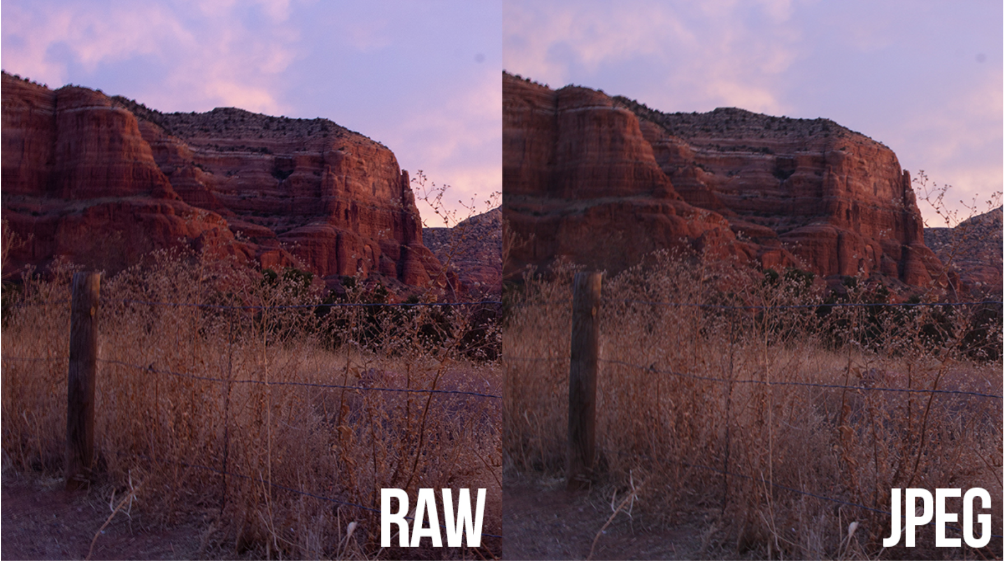
RAW vs JPEG

Slide 6
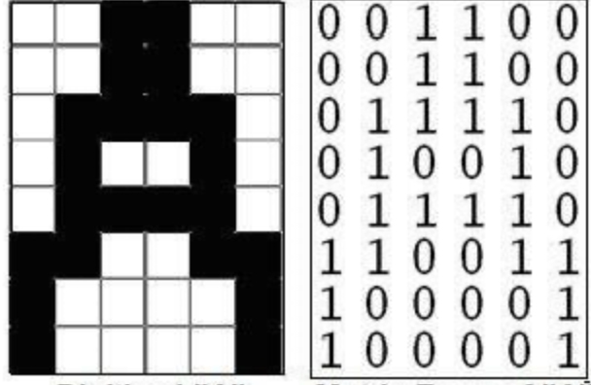
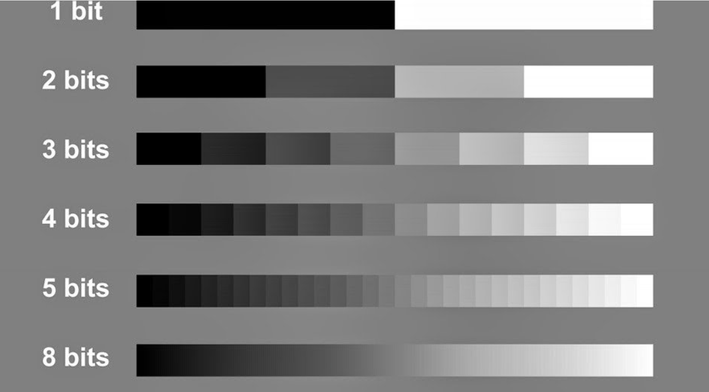
Variation of bits in greyscale image (Banding Effect)

Slide 7


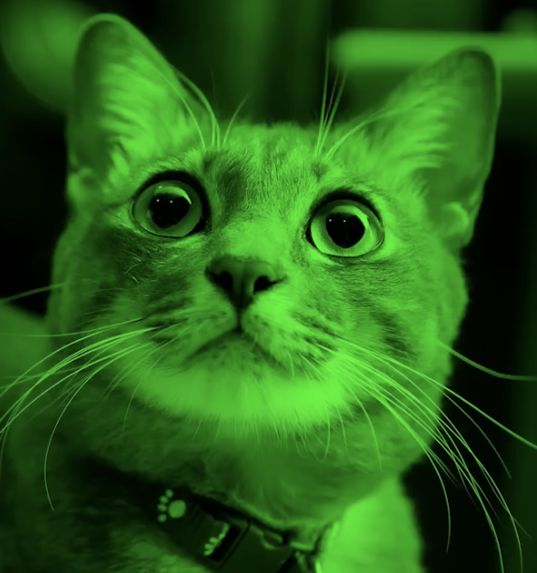
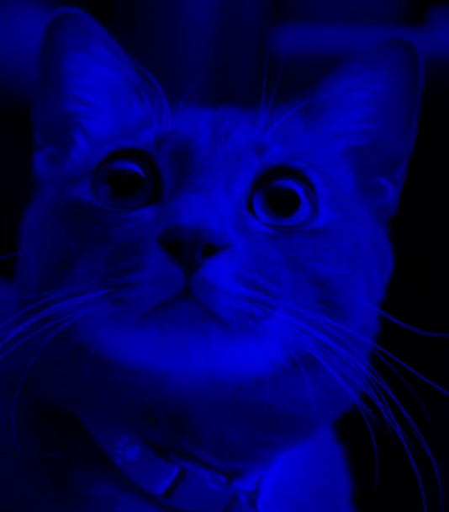
Color image (RGB)

Slide 8
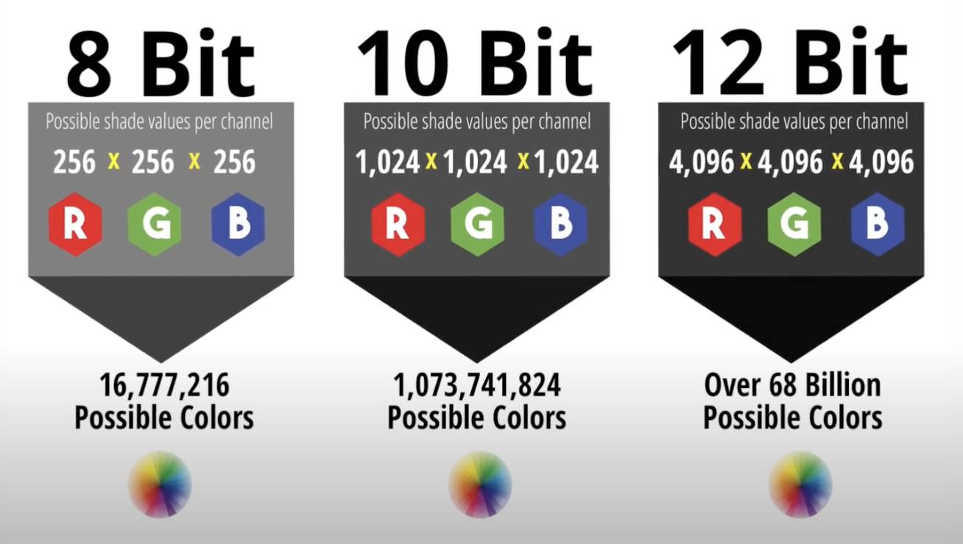
Bits and possible colors

Slide 9
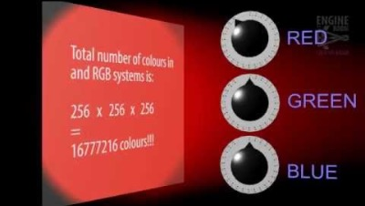
Bits and possible colors

Slide 10
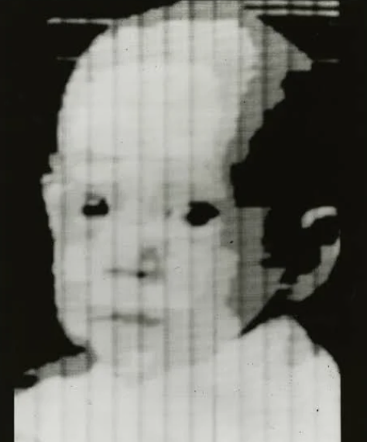
Basic Concepts (2. Resolution)
We use pixels to measure the size of an image by length and height.
The more pixels in an image, the higher its resolution, and typically the finer its level of detail.
Black & white photo of baby appears in the first digital image made on a computer in 1957 showed researcher Russell Kirsch's baby. 176x176 pixels
Today's standard HD image would measure 1920x1080 pixels.
In practice, that means you can zoom in more closely on a high-resolution image before details begin to blur and individual pixels become perceptible.
Higher-resolution images have more pixels per inch, so they can be printed at larger sizes before they lose detail.

Slide 11
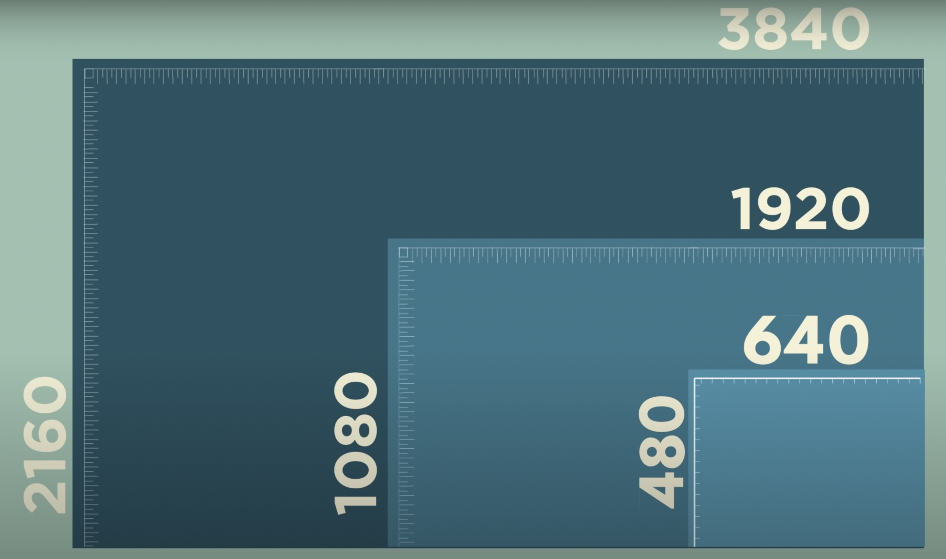
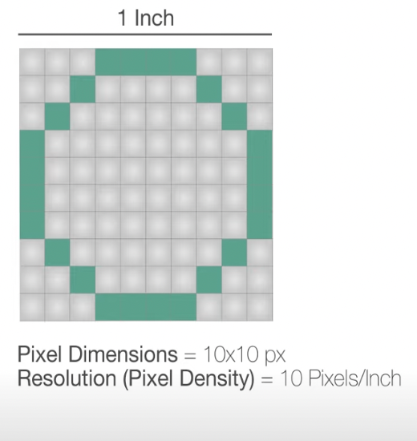
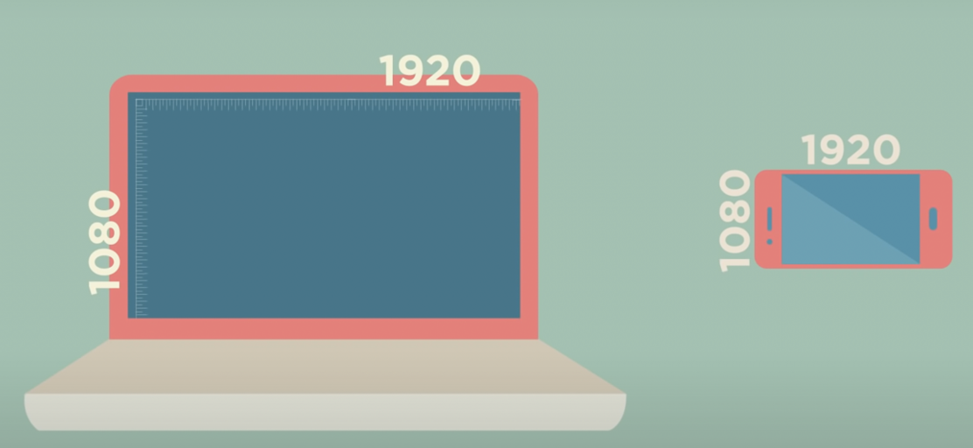
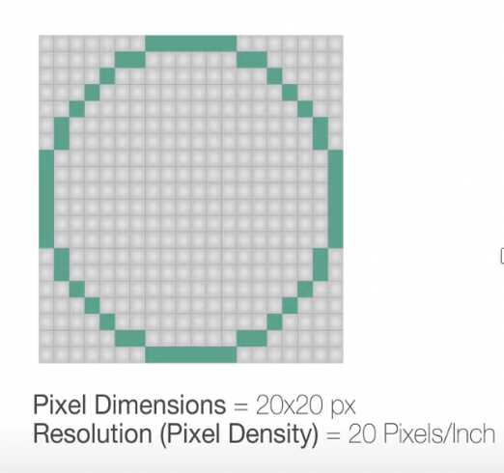
Resolution and Density
A 1080p resolution on a 24-inch monitor has lower PPI compared to the same resolution on a 13-inch laptop because the pixels are spread over a larger area on the bigger screen.

Slide 12
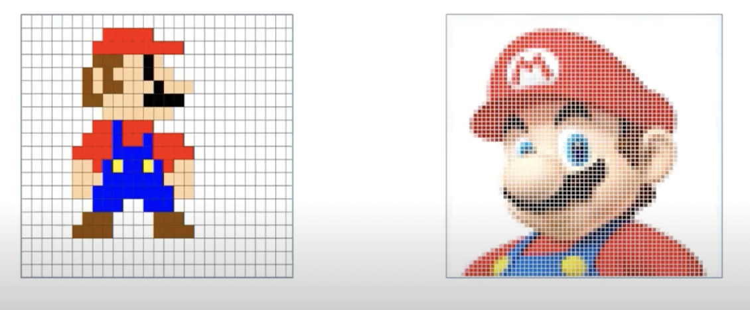
Resolution

Slide 13

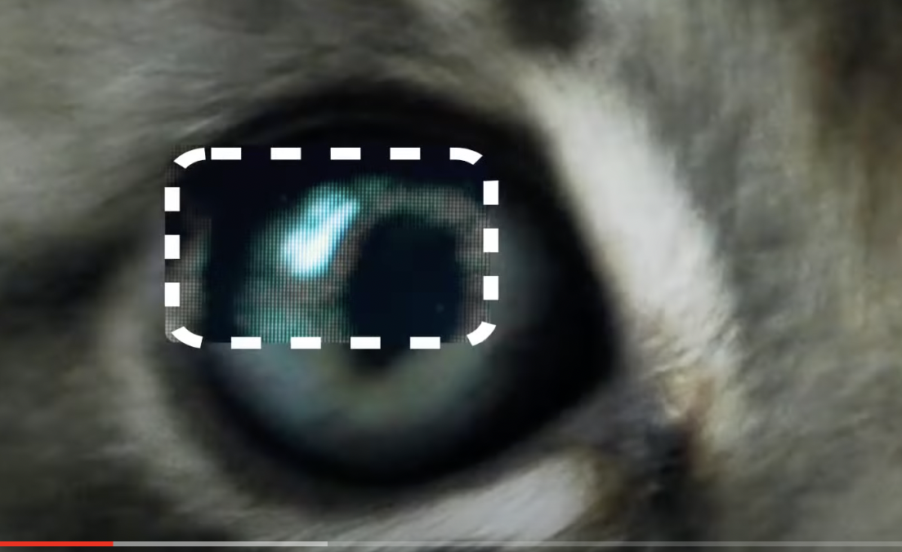


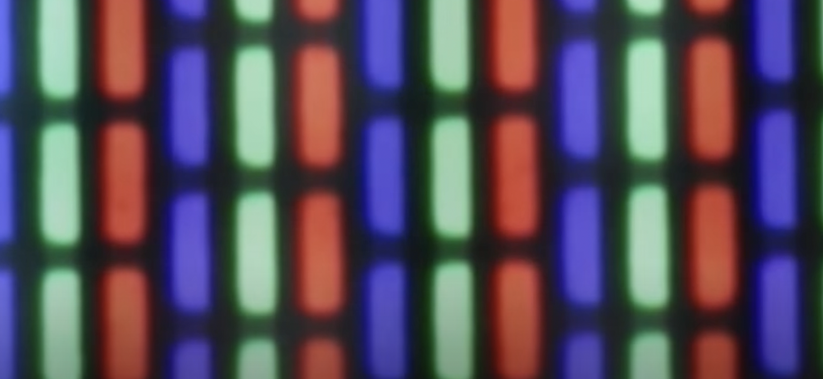
RGB Example

Slide 14
Image Size
Computer storage is less of a concern today, but image size still matters for such things as how many photos a camera can hold or how long it takes to send a picture to or from a mobile phone.
Because a digital image is an array of pixels, three things determine its size:
The width of the image in pixels
The height of the image in pixels
The pixel depth, or number of bits used to represent one pixel.
Total image size, in bits, is simply the product of these three quantities:
S = w × h × d where S is the image size in bits, w is its width in pixels, h is its height in pixels, and d is its depth in bits

Slide 15
Example
Consider a digital photograph that is 1748 pixels wide by 1240 pixels high and uses 8 bits for each of the red, green, and blue primary colors in each pixel.
This photo’s pixel depth is the total number of bits in one pixel, or 8 + 8 + 8, i.e., 24.
The total number of bits in the photo is then 1748 × 1240 × 24 = 52,020,480 bits.
Since one byte is 8 bits, dividing by 8 gives the size in bytes, a more conventional unit of the size of digital documents: 52,020,480 ÷ 8 = 6,502,560, or about 6 megabytes.

Slide 16
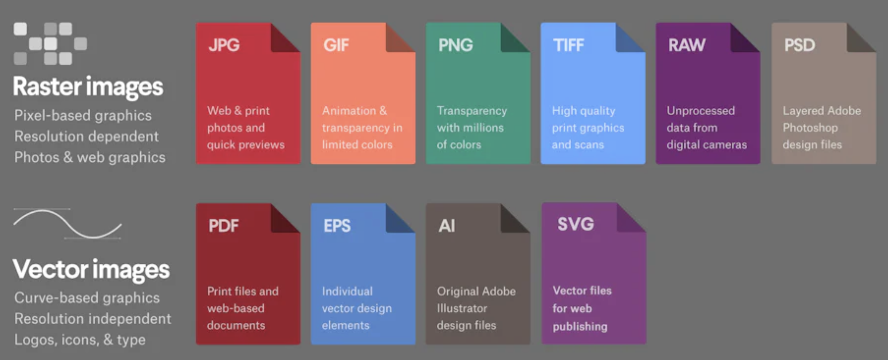
Image Formats

Slide 17
Image Formats
TIFF (.tif, .tiff)
TIFF or Tagged Image File Format are lossless images files meaning that they will not lose any image quality or information (although there are options for compression), allowing for very high-quality images but also larger file sizes.
Compression: Lossless - no compression. Very high-quality images. Best For: High quality prints, professional publications, archival copies Special Attributes: Can save transparencies
Bitmap (.bmp)
BMP or Bitmap Image File is a format developed by Microsoft for Windows. There is no compression or information loss with BMP files which allow images to have very high quality, but also very large file sizes. Due to BMP being a proprietary format, it is generally deprecated in favor of TIFF files.
Compression: None Best For: High quality scans, archival copies

Slide 18
Image Formats
JPEG (.jpg, .jpeg)
JPEG, which stands for Joint Photographic Experts Groups is a “lossy” format, meaning that the image is compressed to make a smaller file. The compression does create a loss in quality but this loss is generally not noticeable. JPEG files are very common on the Internet and JPEG is a popular format for digital cameras - making it ideal for web use and non-professional prints. Compression: Lossy - some file information is compressed or lost Best For: Web Images, Non-Professional Printing, E-Mail, Powerpoint Special Attributes: Can choose amount of compression when saving in image editing programs like Adobe Photoshop

Slide 19
Image Formats
GIF (.gif)
GIF or Graphics Interchange Format files are widely used for web graphics, because they are limited to only 256 colors, can allow for transparency, and can be animated. GIF files are typically small in size and are very portable.
Compression: Lossless - compression without loss of quality Best For: Web Images Special Attributes: Can be Animated, Can Save Transparency
PNG (.png)
PNG or Portable Network Graphics files are a lossless image format originally designed to improve upon and replace the gif format. PNG files are able to handle up to 16 million colors, unlike the 256 colors supported by GIF.
Compression: Lossless - compression without loss of quality Best For: Web Images Special Attributes: Save Transparency

Slide 20
Image Formats
RAW Image Files (.raw, .cr2, .nef, .orf, .sr2, and more)
RAW images are images that are unprocessed that have been created by a camera or scanner. Many digital SLR cameras can shoot in RAW, whether it be a .raw, .cr2, or .nef. These RAW images are the equivalent of a digital negative, meaning that they hold a lot of image information, but still need to be processed in an editor such as Adobe Photoshop or Lightroom.
Compression: None Best For: Photography Special Attributes: Saves metadata, unprocessed, lots of information

Slide 21
Dithering
Dithering in image processing is a technique used to simulate colors or shading.
The basic concept behind dithering is adding noise, or additional pixels, to a digital file
In graphics, dithering adds random patterns of pixels to improve the image quality while avoiding banding.
In its earlier uses in newspapers, comic books, and other printed media, dithering would be applied to images to create levels of simulated grayscale by strategic placement of black dots. Using the dithering process would give a smooth image with gray shades even though printing presses only supported black ink.
Comic books and other color printing worked similarly, but to simulate more shades of color than the limited palette printing presses had.

Slide 22
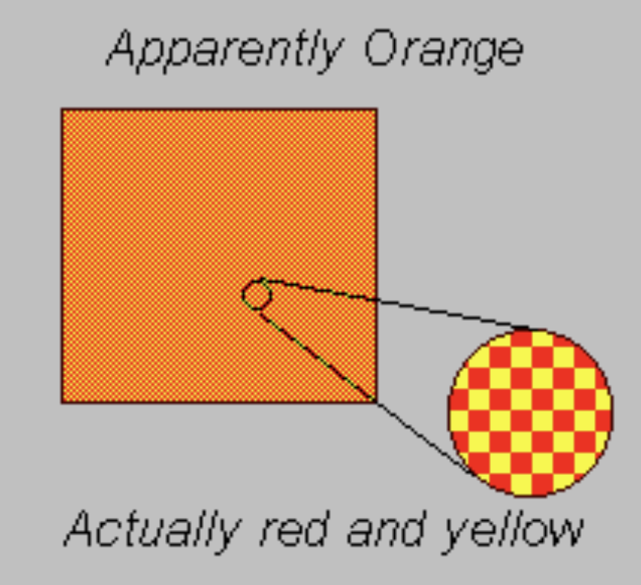
Dithering..contd
Using dithering in image processing not only reduces banding of colors and shading, which creates a smoother finished image, but it also reduces the file size.
If we view a very small area from a sufficiently large viewing distance, our eyes will average the overall detail and record only the overall intensity of that area.
This phenomenon is also called Halftoning.

Slide 23
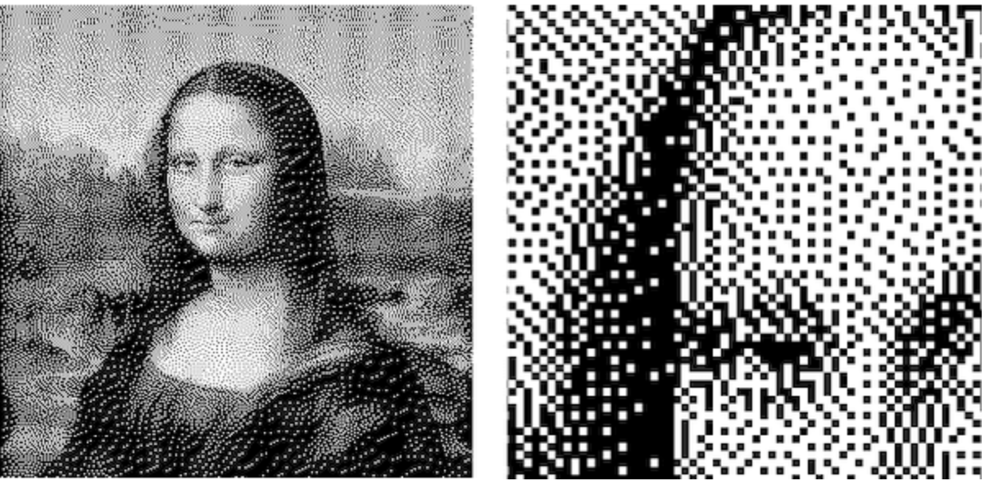
Dithering_Example

Slide 24


: 16-color to 5 color

Slide 25

Dithering result of 5 color

Slide 26
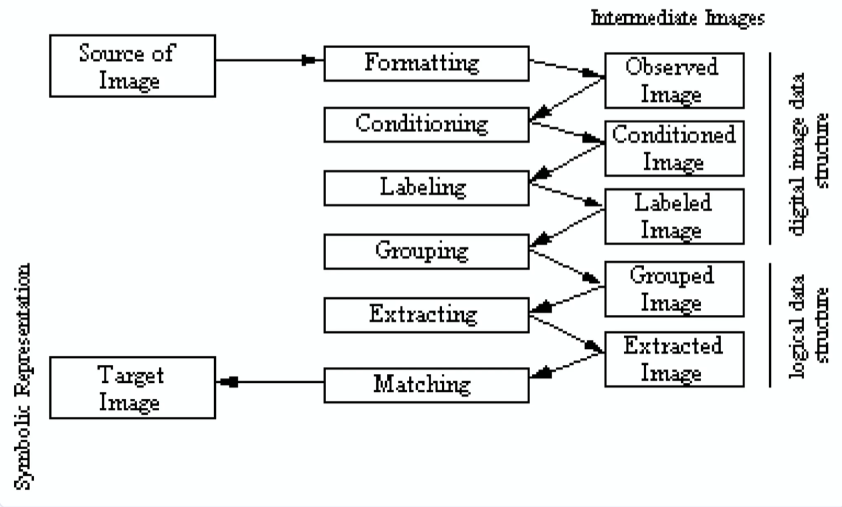
Image recognition steps

Slide 27
1. Formatting
The Formatting step in the image recognition process is a crucial preprocessing stage where the raw input image is prepared for further analysis. It ensures that the image is in a standardized and usable format for the subsequent processing steps.
Objective: Standardize the image for subsequent processing.
Output: The Observed Image.
This step involves preprocessing tasks such as:
Resizing the image to fit the expected input dimensions.
Converting color formats (e.g., RGB to grayscale).
Handling compression artifacts or noise.

Slide 28
Key Tasks in the Formatting
1. Image Resizing
Ensures the image matches the required dimensions of the system.
Example: If a neural network requires input images of size 224×224, all images must be resized accordingly.
2. Color Space Conversion
Converts the image to a specific color space, depending on the application.
Common transformations:
Grayscale conversion: Reduces color complexity by converting a 3-channel RGB image to a single channel.
Binary conversion: Converts to black-and-white using thresholding for simple applications like OCR.

Slide 29
Key Tasks in the Formatting
3. Cropping or Padding
Cropping:
Removes unwanted areas from the image, focusing on the region of interest (ROI).
4. File Format Conversion
Converts the image into a compatible file format (e.g., from BMP or TIFF to PNG or JPEG).
Reduces file size if necessary without losing critical information.
5. Resolution Adjustment
Adjusts the resolution of the image to balance between processing speed and quality.
Low-resolution images are faster to process but may lose details critical for tasks like object recognition.

Slide 30
Key Tasks in the Formatting
6. Noise Removal
Preliminary noise filtering may occur to remove pixel artifacts caused by compression or environmental factors.
Techniques:
Median filtering (to handle salt-and-pepper noise).
Smoothing filters (e.g., Gaussian blur).

Slide 31
Benefits of the Formatting Step
Reduces computational overhead by standardizing inputs.
Improves processing accuracy by eliminating irrelevant information (e.g., unnecessary borders, noise).
Ensures compatibility with image recognition algorithms and models.

Slide 32
2. Conditioning
The Conditioning step is a critical stage in the image recognition process, where the formatted image is enhanced to improve the quality and extractability of its features. This step optimizes the image to make it more suitable for feature extraction and subsequent analysis.
Objective: Enhance image quality and optimize it for feature extraction.
Output: The Conditioned Image.
Common techniques:
Noise reduction (e.g., Gaussian smoothing).
Contrast adjustment or histogram equalization.
Edge enhancement for better feature visibility.

Slide 33
Key Tasks in the Conditioning
1. Noise Reduction: Using Filters
2. Contrast Enhancement e.g. Histogram Equalization
3. Edge Enhancement
4. Illumination Correction e.g. Correcting shadows in a photograph to reveal obscured details.
5. Geometric Transformations: Scaling, Rotation
6. Thresholding
7. Normalization e.g. Standardizes pixel intensity values across the image to maintain consistency.

Slide 34
Benefits of Conditioning
Enhanced Features: Makes key image components more prominent.
Improved Accuracy: Reduces errors in feature extraction and recognition.
Robustness: Compensates for variations in image quality or acquisition conditions.
Consistency: Ensures uniform processing across diverse image datasets.

Slide 35
3. LAbeling
It is a crucial stage where the processed image is segmented into meaningful regions or components, each of which is labeled for further analysis. This step often bridges the gap between raw image data and symbolic representations, making it fundamental for understanding and interpreting the image content.
Objective: Assign identifiers or labels to distinguish different regions or objects in the image.
Output: The Labeled Image. Processes involved: Segmentation: Dividing the image into meaningful regions (e.g., foreground and background).
Labeling objects within these regions for further analysis.

Slide 36
Applications of Labeling
1: Medical Imaging: Identify and label different tissues or abnormalities.
2: Autonomous Driving: Detect and label objects in a road scene.
3. Satellite Imaging: Identify and label regions of interest (e.g., buildings, forests, water bodies).

Slide 37
Benefits of Labeling
Facilitates Object Recognition: Clearly distinguishes different objects or regions in the image.
Supports Feature Extraction: Labeled data can guide subsequent steps like grouping and matching.
Improves Model Training: Labeled datasets are essential for training supervised learning models.

Slide 38
4. Grouping
This step bridges the gap between low-level features (e.g., individual pixels or labeled regions) and high-level understanding (e.g., objects, patterns, or scenes).
Objective: Cluster similar components or regions of the labeled image.
Output: The Grouped Image.
Steps:
Combine related pixels or regions based on features like color, texture, or shape.
Group objects that are part of the same entity (e.g., merging parts of a car into a single object).

Slide 39
Key Tasks in the Grouping
1. Proximity-Based Grouping
Groups regions or objects based on their spatial closeness.
Techniques:
Clustering:
Uses algorithms like K-means or DBSCAN to group nearby regions.
Nearest Neighbor:
Links components based on the shortest distance between them.
Example: Grouping dots in a scatter plot into clusters to form a recognizable shape.

Slide 40
5. Extracting
The Extracting step in the image recognition process is focused on isolating and obtaining meaningful information or features from the grouped or labeled image data.
Objective: Isolate critical features or objects of interest.
Output: The Extracted Image.
Methods: Feature extraction: Identifying and preserving key attributes (e.g., edges, corners, blobs).
ROI (Region of Interest) extraction: Focus on specific areas in the image containing valuable information.

Slide 41
Steps of the Extracting
Feature Derivation:
Extracts meaningful features (e.g., shapes, textures, edges) that represent objects in the image.
Region Extraction:
Isolates specific areas or objects from the image based on prior grouping or segmentation.
Dimensionality Reduction:
Reduces the complexity of the image data while retaining important information.
Preparation for Matching or Classification:
Prepares the extracted data for use in decision-making or pattern recognition tasks.

Slide 42
6. matching
The Matching step in the image recognition process is the final phase, where the features or objects extracted from the image are compared against a reference dataset, symbolic representation, or predefined template to identify or classify the image.
Objective: Compare the extracted features or objects with a known reference or Target Image.
Output: Symbolic Representation. This step involves : Template matching: Comparing with predefined patterns.
Using symbolic data (logical representations) to recognize or classify objects.
Matching could also rely on algorithms like neural networks or statistical methods for higher accuracy.

Slide 43
Benefits of the Matching
Accurate Identification: Matches extracted features to specific patterns or objects with high precision.
Enables Decision-Making: Provides conclusive results for tasks like object recognition or classification.
Supports Automation: Facilitates automated systems by matching features without human intervention.

Slide 44
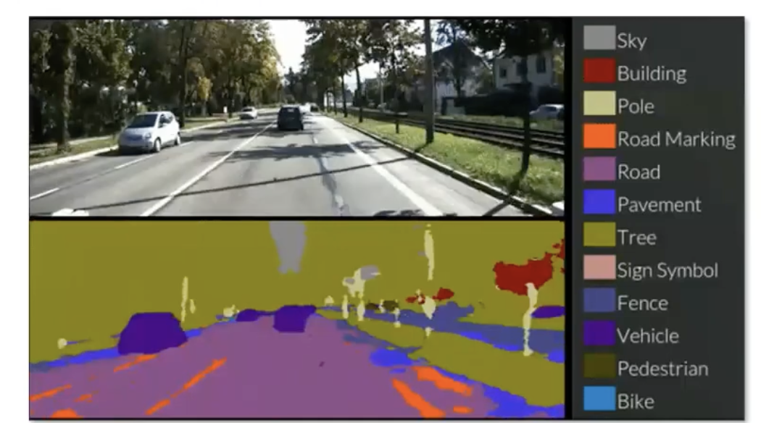
Segmentation

Slide 45
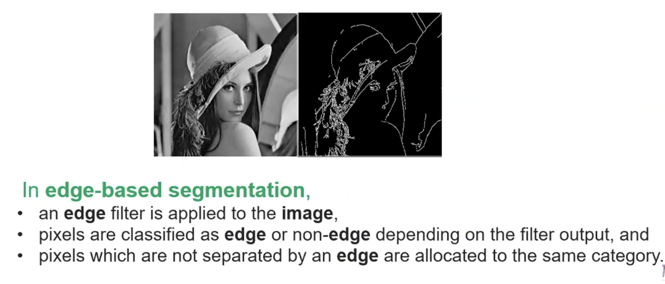
Edge Detection

Slide 46
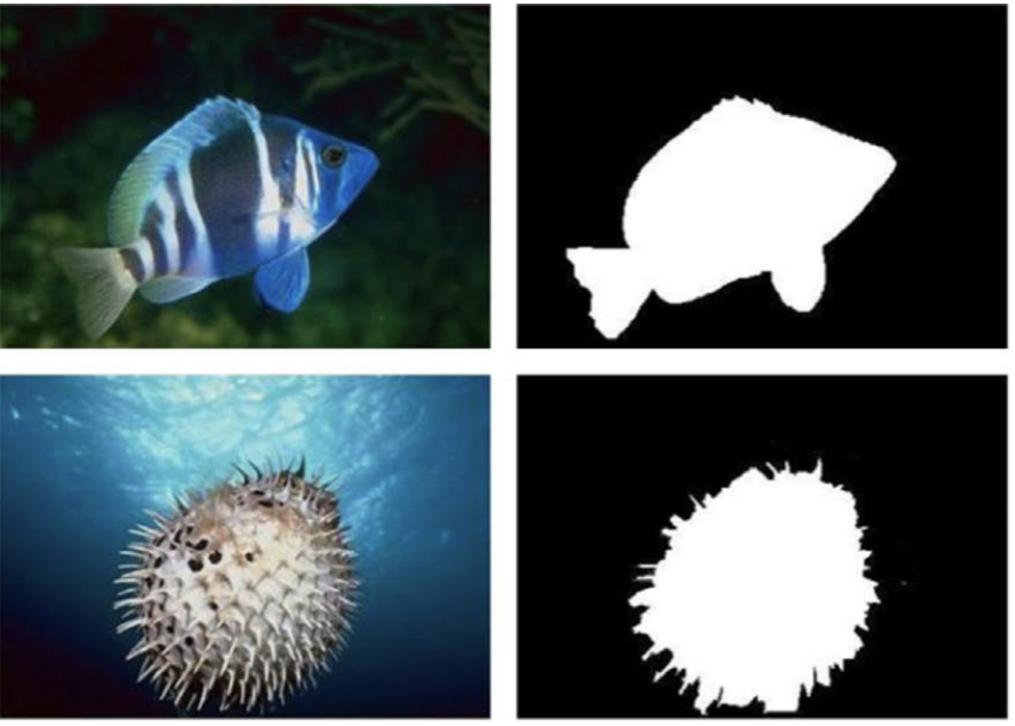
Binary Thresholding

Slide 47
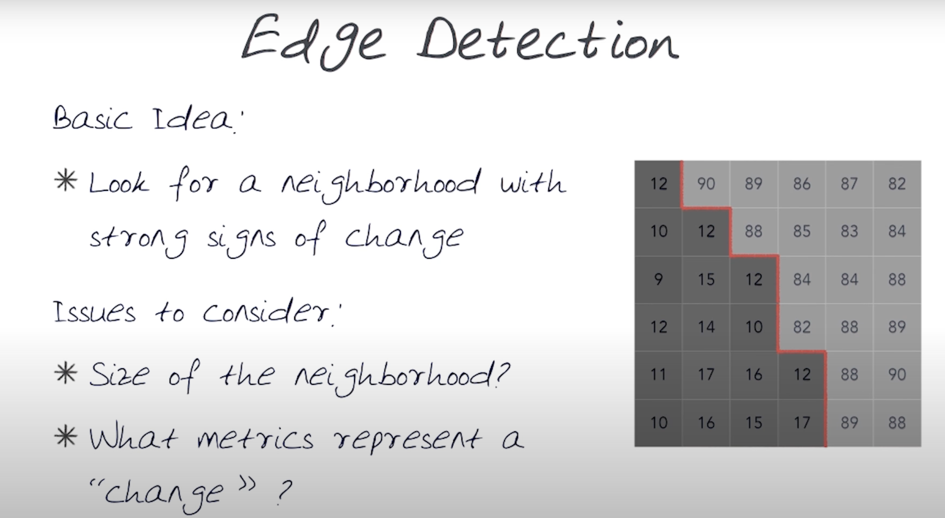
Edge Detection

Slide 48
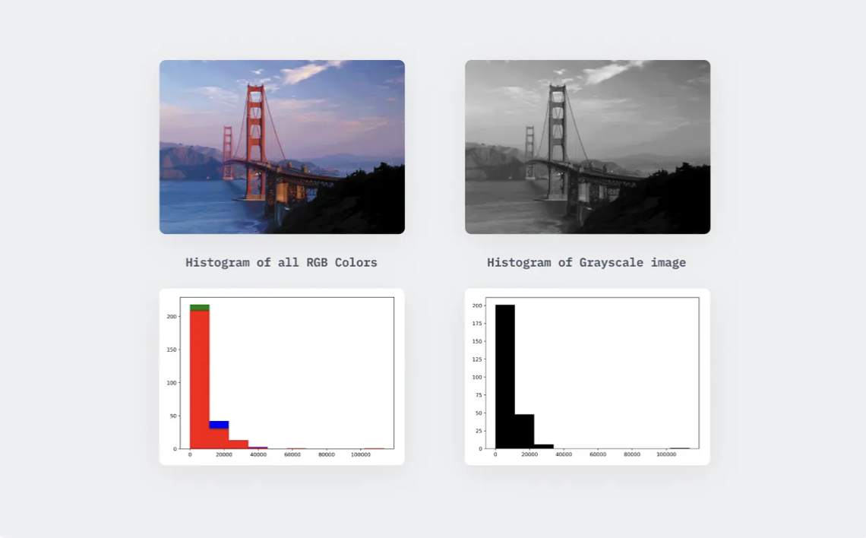
Histogram

Slide 49
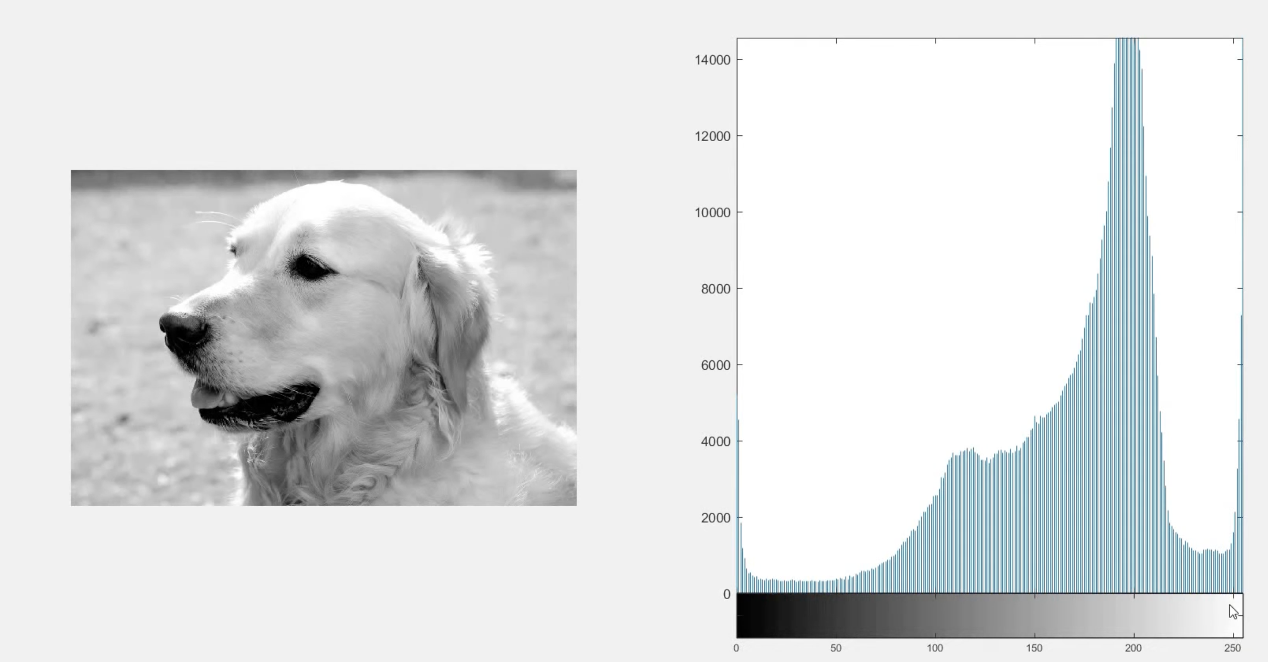
Histogram

Slide 50
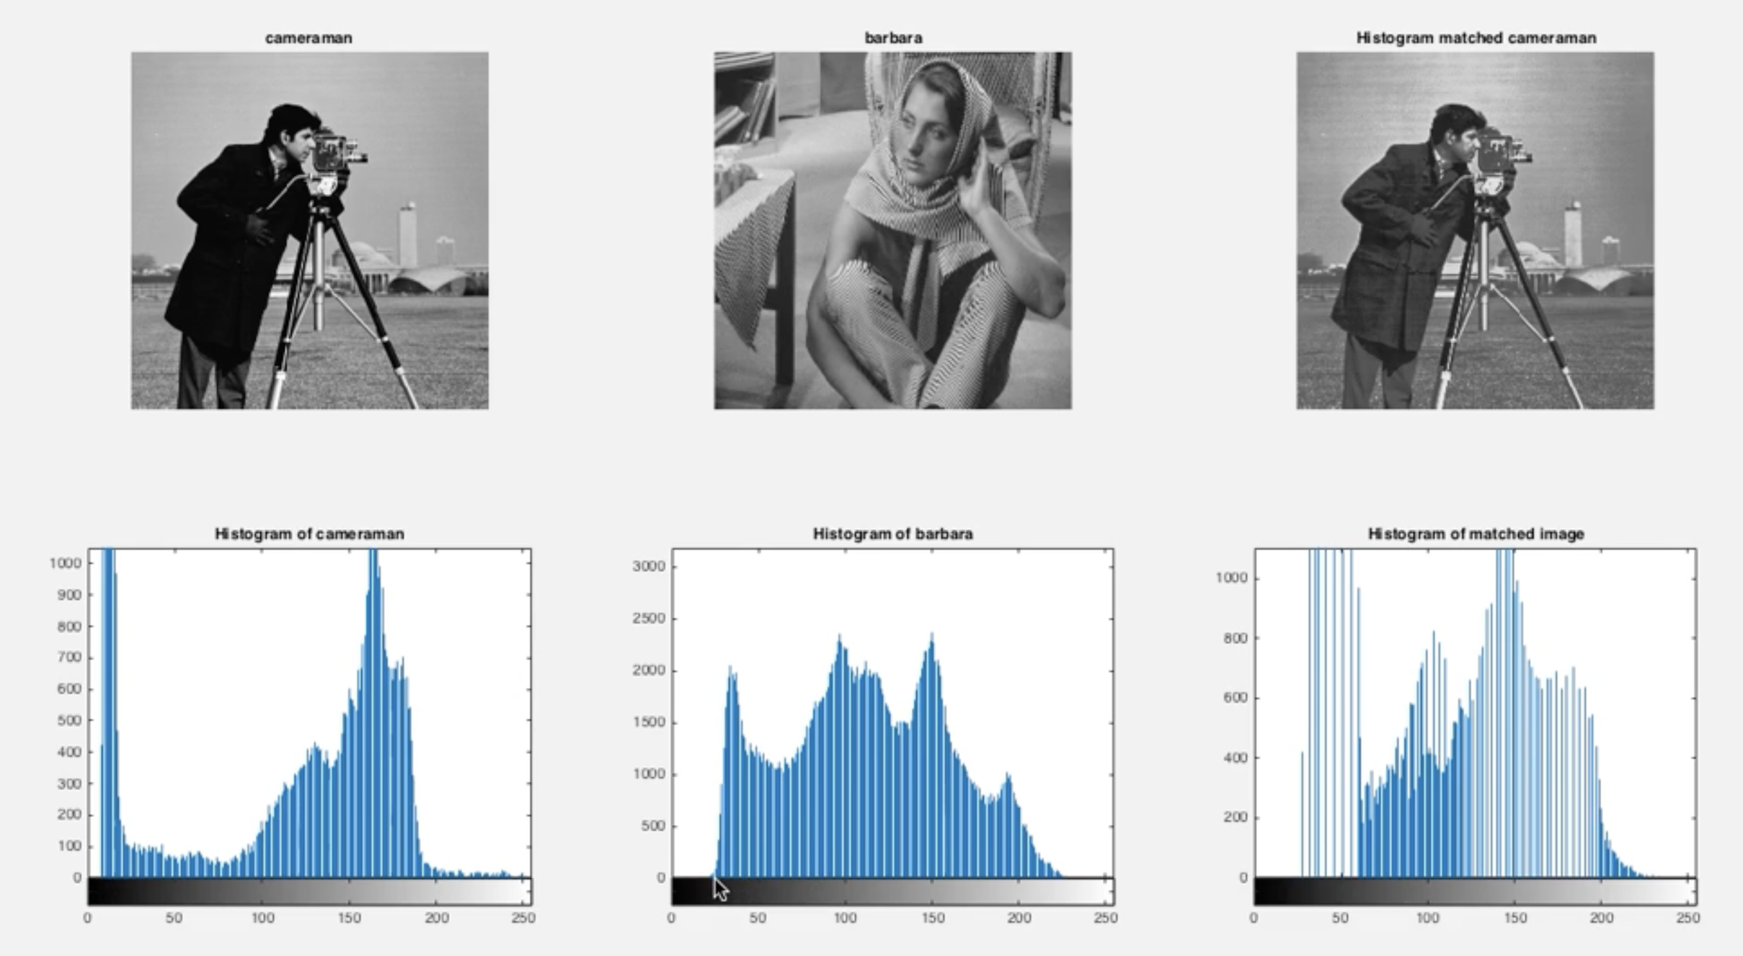
Histogram

Slide 51
END of chapter 3

